Slide 1

CSE 2215: Data Structures and Algorithms I
ASIF ABRAR
Lecturer, Department of Computer Science and Engineering,
United International University

Slide 2
Trees & Tree Traversal

Slide 3

What is a Tree?
A connected acyclic graph is a tree
In computer science, a tree is an abstract model
of a hierarchical structure
A tree consists of nodes with
a parent-child relationship
Applications:
Organizational charts
File systems
Programming environments

Slide 4
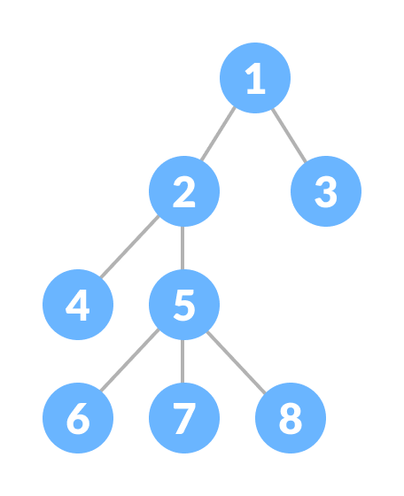
What is a Tree?
A connected acyclic graph is a tree.
A tree T is a set of nodes in a parent-child
relationship with the following properties:
T has a special node r, called the root of T, with no parent node
Each node v of T, different from r, has a unique parent node u

Slide 5

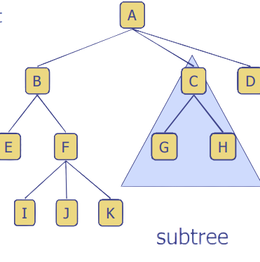
Tree Terminology
Root: node without parent (A)
Internal node: node with at least one child (A, B, C, F)
External node (Leaf ): node without children (E, I, J, K, G, H, D)
Ancestors of a node: parent, grandparent, grand-grandparent, etc.
Descendants of a node: child, grandchild, grand-grandchild, etc.
Subtree: tree consisting of a node and its descendants

Slide 6
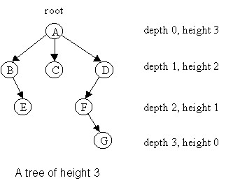
Depth
The depth of a node v can be recursively defined as follows
If v is the root, then the depth of v is 0.
Otherwise, the depth of v is one plus the depth of the parent of v
Algorithm
depth(T, v)
if T.isRoot(v) then
return 0
else
return 1 + depth(T, T.parent(v))
Running time: O(1 + d_{v}), d_{v} is depth of v in T
In worst case O(n), n is the number of nodes in T

Slide 7
Height
The height of a node v can be recursively defined as follows
If v is a leaf node, then the height of v is 0.
Otherwise, the height of v is one plus the maximum height of a child of v
The height of a tree T is the height of the root of T
The height of a tree T is equal to the maximum depth of a leaf node of T

Slide 8
Height
Algorithm height(T, v)
if T.isLeaf(v) then return 0
else
h = 0
for each w εT.children(v) do
h = max(h, height(T, w))
return 1 + h
Running time: O(Σ_{v ε T} (1 + c_{v})), where c_{v} is the number of children of v in T
Since Σ_{v ε T} c_{v =} n - 1, we have O(Σ_{v ε T} (1 + c_{v})) = O(n).
The height of tree T is obtained by calling height(T, r).

Slide 9
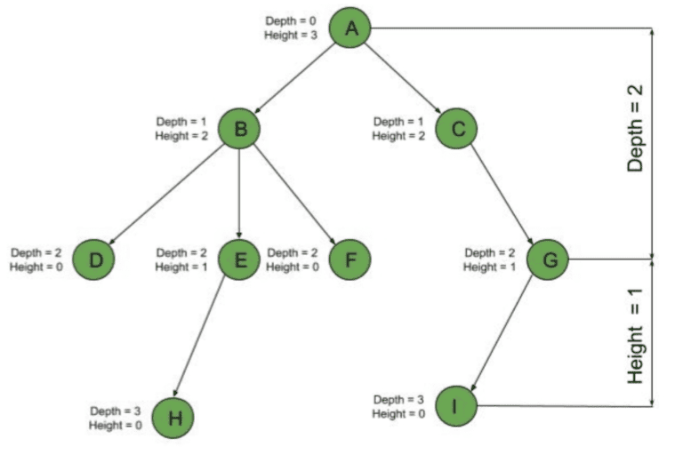

Slide 10
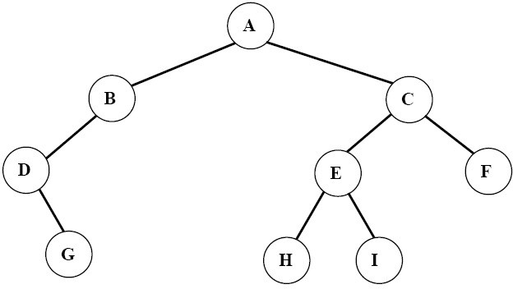
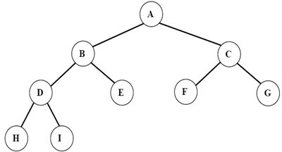
Ordered Trees
A tree is ordered if there is a linear ordering defined for each child of each node.
A binary tree is an ordered tree in which every node has at most two children.
If each node of a tree has either zero or two children, the tree is called a proper binary tree.
Binary Tree
Proper Binary Tree

Slide 11
Traversal of Trees
A traversal of a tree T is a systematic way of visiting all the nodes of T
Traversing a tree involves visiting the root and traversing its subtrees
There are the following traversal methods:
Preorder Traversal
Postorder Traversal
Inorder Traversal (of a binary tree)

Slide 12
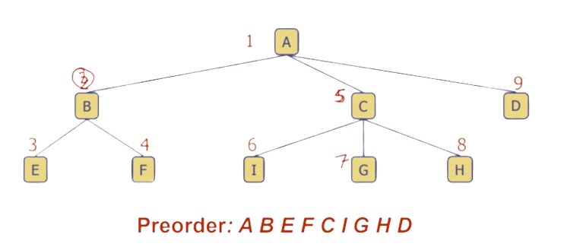
Preorder Traversal (General Tree)
In a preorder traversal, a node is visited before its descendants
If a tree is ordered, then the subtrees are traversed according to the order of the children

Slide 13
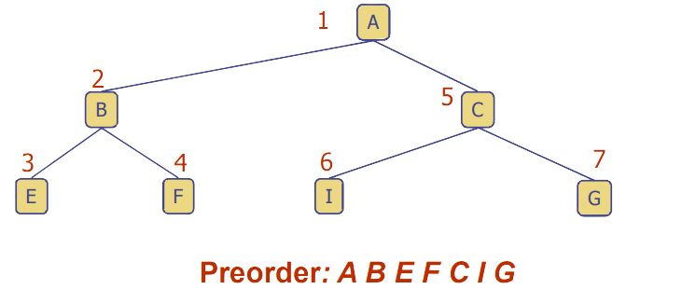
Preorder Traversal (Binary Tree)
Traversing a binary tree in Preorder
Visit the root.
Traverse the left subtree in Preorder.
Traverse the right subtree in Preorder.

Slide 14
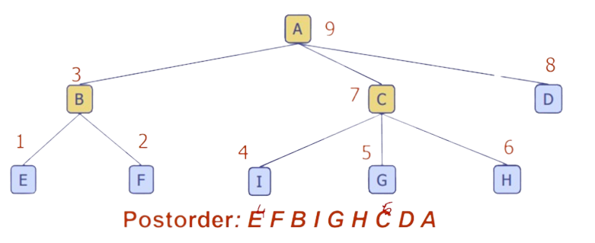
Postorder Traversal (General Tree)
In a postorder traversal, a node is visited after its descendants

Slide 15
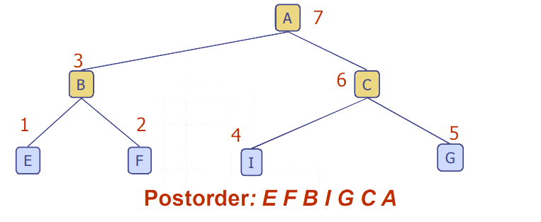
Postorder Traversal (Binary Tree)
Traversing a binary tree in Postorder
Traverse the left subtree in Preorder.
Traverse the right subtree in Preorder.
Visit the root.

Slide 16
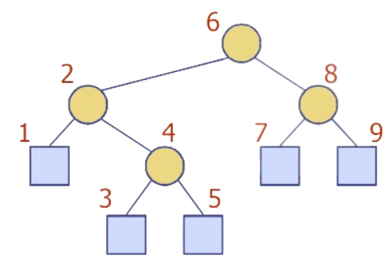
Inorder Traversal
In a postorder traversal, a node is visited between its descendants

Slide 17
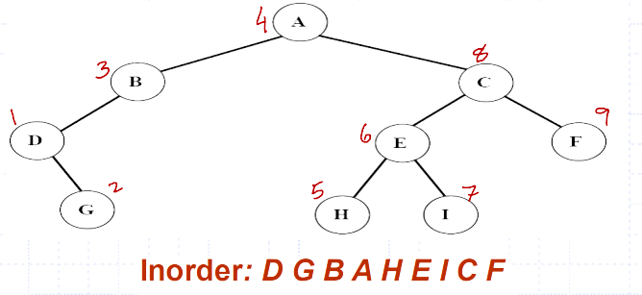
Inorder Traversal
Traversing a binary tree in inorder
Traverse the left subtree in inorder.
Visit the root.
Traverse the right subtree in inorder.

Slide 18
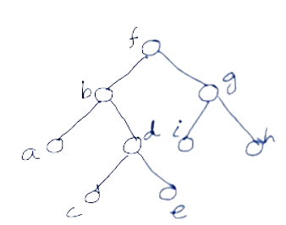

Preorder, Inorder, Postorder Traversals: Example

Slide 19
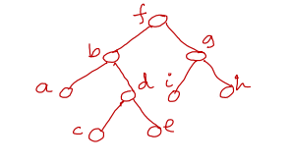
Construct a Binary Tree from Preorder & Inorder
Preorder: f → b → a → d → c → e → g → i → h
Inorder: a → b → c → d → e → f → i → g → h

Slide 20
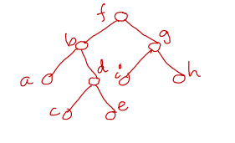
Construct a Binary Tree from Postorder & Inorder
Postoder: a → c → e → d → b → i → h → g → f
Inorder: a → b → c → d → e → f → i → g → h

Slide 21
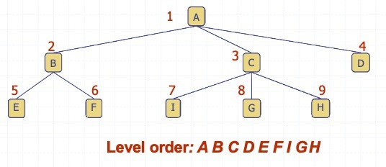
Level Order Traversal
In a level order traversal, every node on a level is visited before going to a lower level

Slide 22
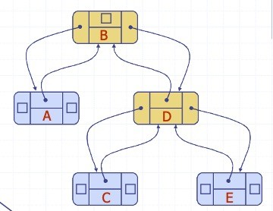
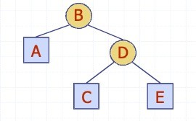
Linked Structure for Binary Trees
A node is represented by an object storing
Element
Parent node
Left child node
Right child node

Slide 23
Codes for Creation of Binary Trees
A binary tree can be created recursively. The program will work as follow:
Read a data in x.
Allocate memory for a new node and store the address in pointer p.
Store the data x in the node p.
Recursively create the left subtree of p and make it the left child of p.
Recursively create the right subtree of p and make it the right child of p.

Slide 24
Codes for Creation of Binary Trees
#include<stdio.h>
typedef struct TreeNode {
struct TreeNode *left;
int data;
struct TreeNode *right;
} TreeNode;

Slide 25
Codes for Creation of Binary Trees
TreeNode * createBinaryTree( ){
TreeNode *p;
int x;
printf("Enter data(-1 for no data): ");
scanf("%d", &x);
if(x == -1) return NULL;
//create current node
p = (TreeNode*) malloc(sizeof(TreeNode));
p->data = x;
//recursively create left and right subtree
printf("Enter left child of %d: \n", x);
p->left = createBinaryTree ( );
printf("Enter right child of %d: \n",x);
p->right = createBinaryTree ();
return p; }

Slide 26
Codes for Creation of Binary Tree Traversal
void preorder(TreeNode *t) {
if(t != NULL) {
printf("\n%d", t->data);
preorder(t->left);
preorder(t->right);
}
}
int main() {
TreeNode *root;
root = createBinaryTree ( );
printf("\nThe preorder traversal of tree is: \n");
preorder(root);
}

Slide 27
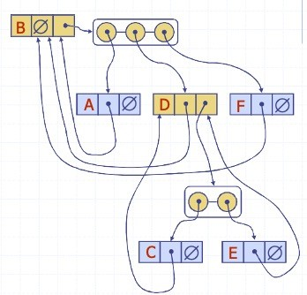
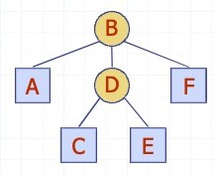
Linked Structure for General Trees
A node is represented by an object storing
Element
Parent node
Children Container: Sequence of children nodes

Slide 28
Questions?

Slide 29
Thank you!

